Slide 1
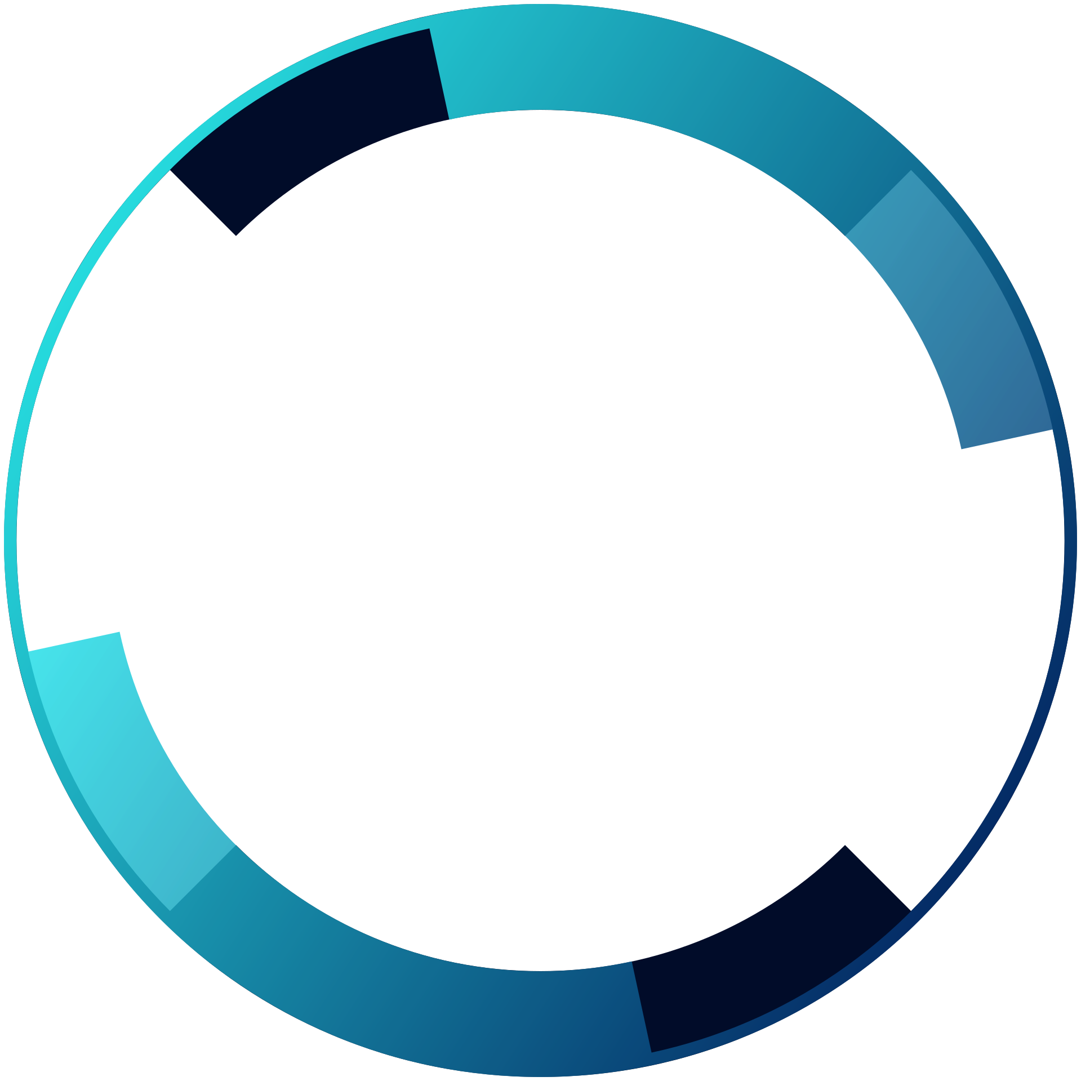

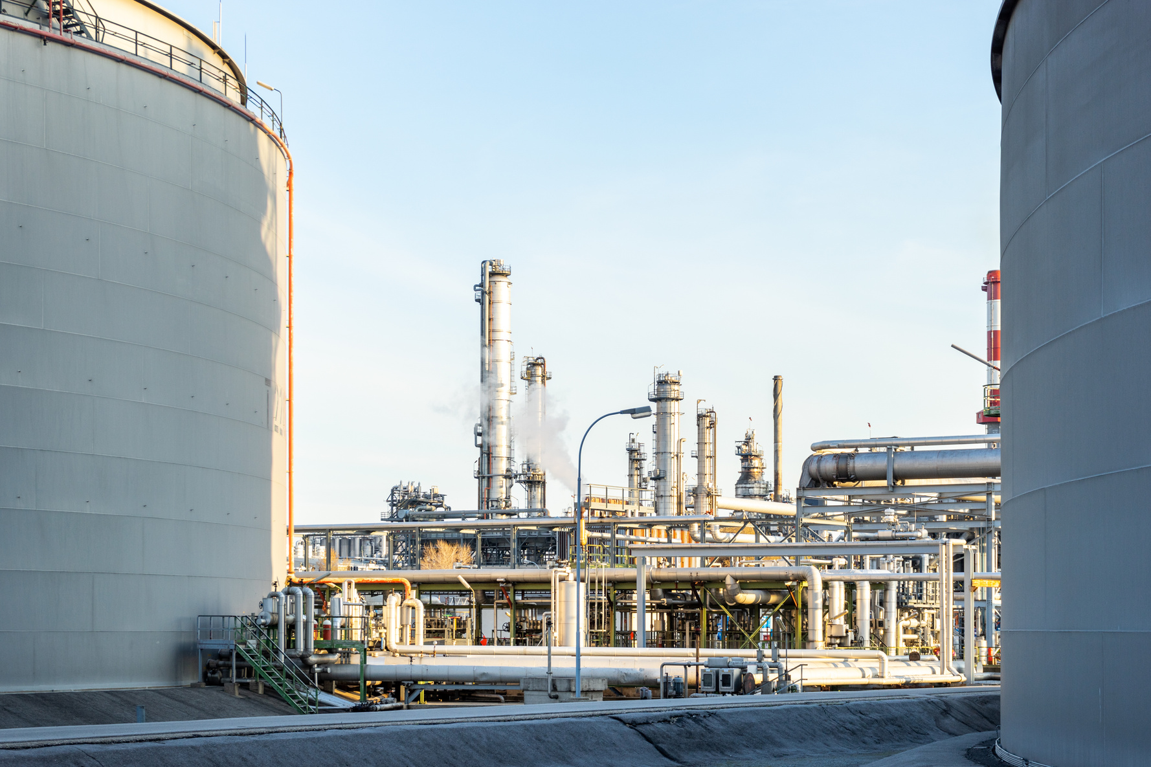



Noor Renewable Energy
E&I CONSTRUCTION MANAGEMENT
SOFTWARE
A Centralized Site Engineering Platform for Construction & Maintenance Projects
https://noorenergy-iq.com

Slide 2
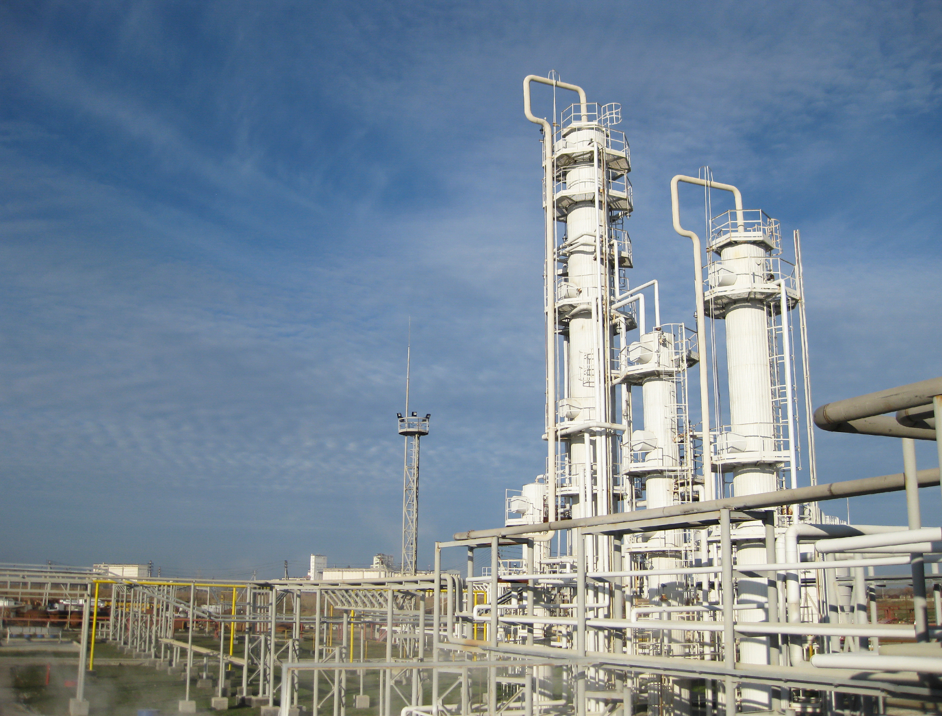

Noor Renewable Energy
INTRODUCTION
Construction-site engineers depend on many project documents: instrument indexes, cable schedules, wiring diagrams, loop drawings, cabinet layouts, I/O lists, datasheets, and installation details.
Finding one instrument or cable path can require opening several PDFs and manually cross-checking information. This wastes engineering time, increases dependency on experienced staff, and creates risk of installation mistakes.
E&I Construction Management solves this by giving engineers one dedicated search engine to access dynamic project data.

Slide 3
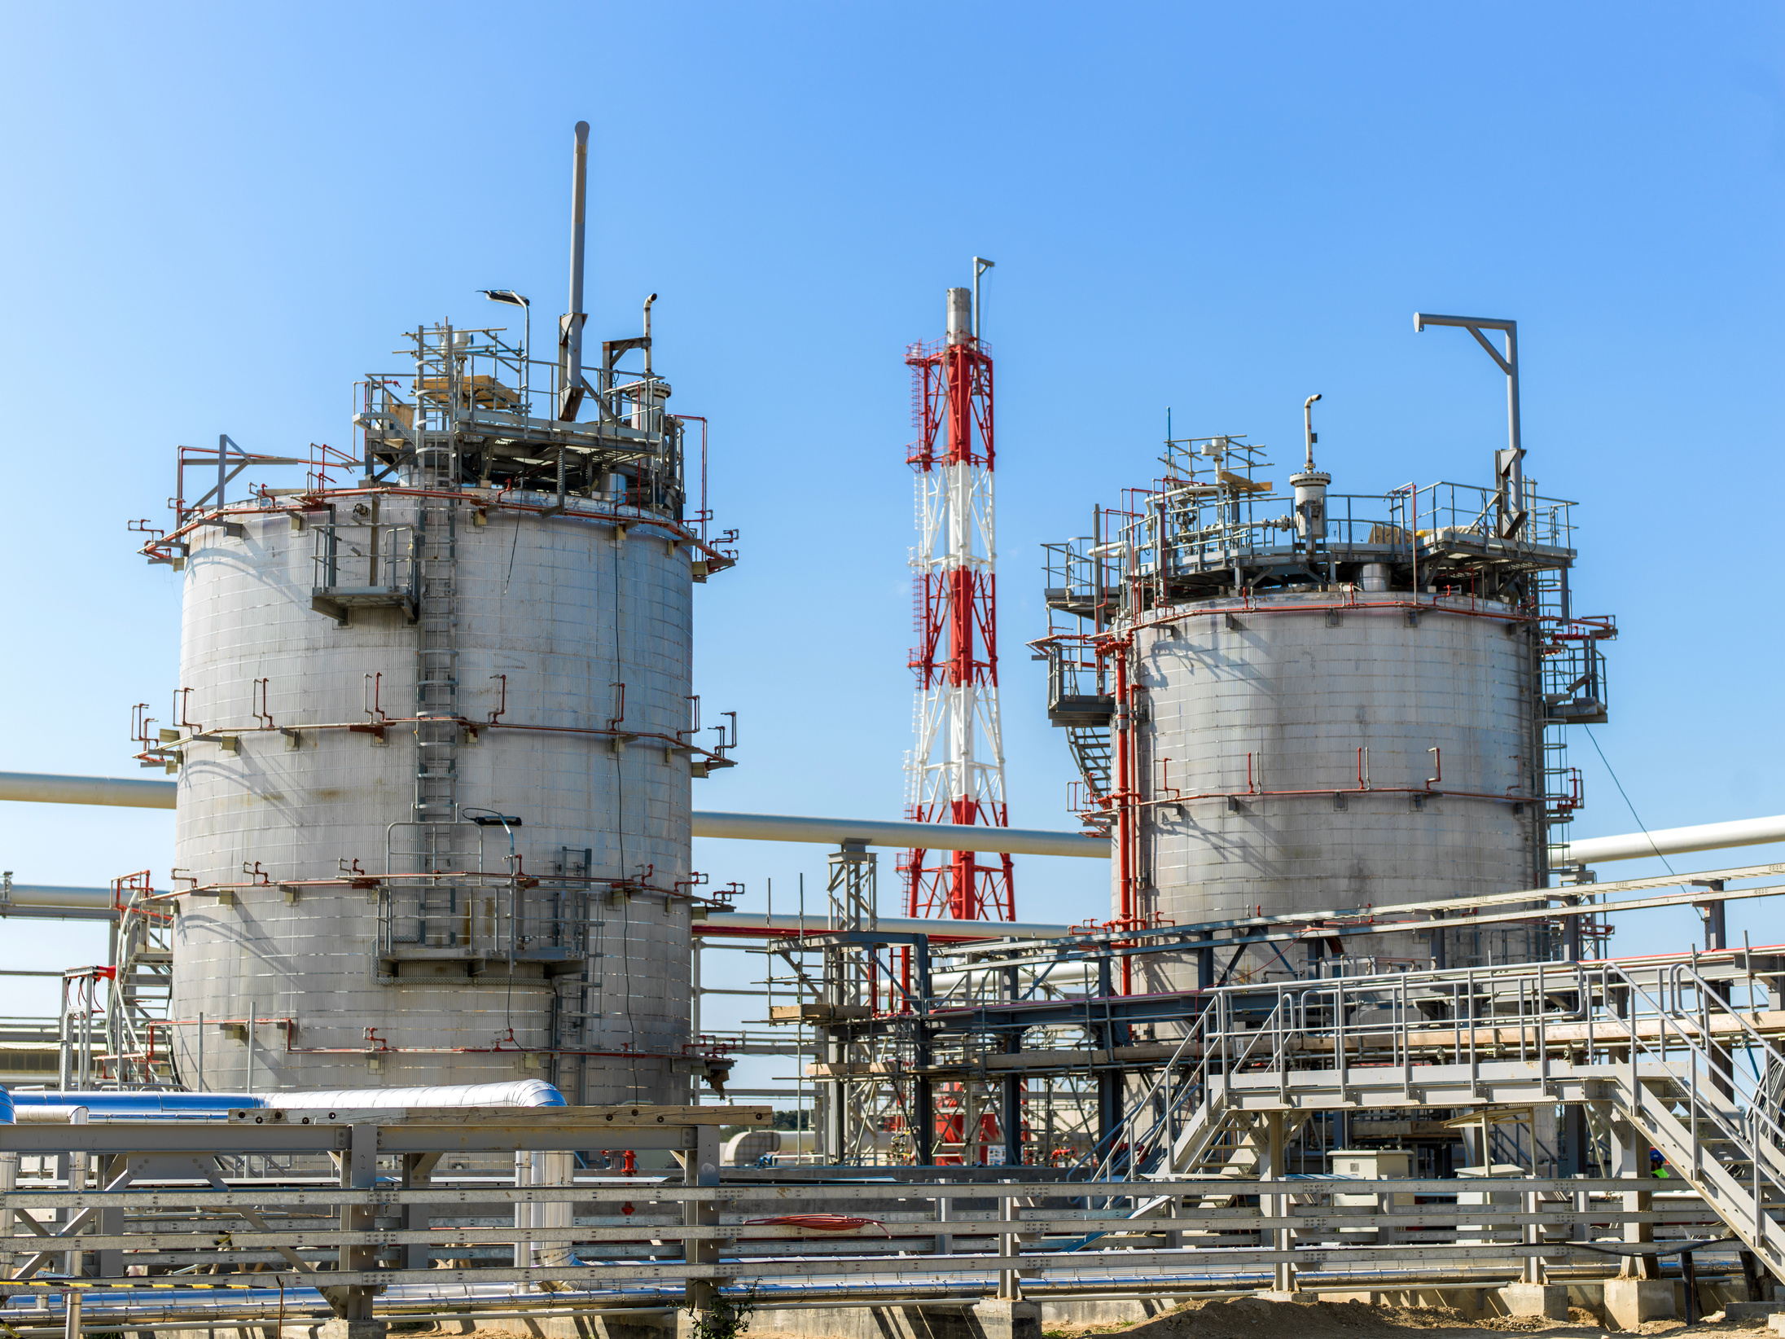

Noor Renewable Energy
WHAT OUR SOFTWARE AIMS TO FIX?
Most companies already have the required project data, but it is locked inside static documents. The problem is not the lack of information, it is the lack of fast, connected, site ready access.
thousends of Engineering Documents
Data is spread across PDFs, drawings, and schedules.
Manual Cross-Referencing
Engineers repeatedly verify the same information.
Weak Field-to-Management Visibility
Progress is often tracked separately from engineering data.

Slide 4



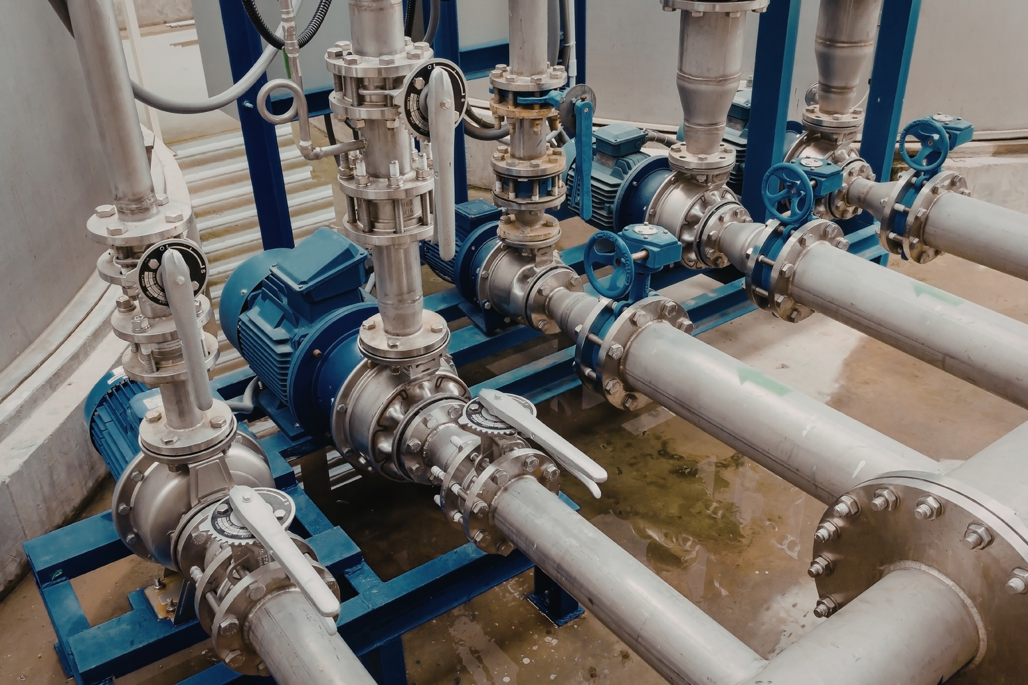
Noor Renewable Energy
OUR SOFTWARE’S MAIN FEATURES PART 1
E&I Construction Management extracts key information from project PDFs and organizes it into a structured, tag-based interface for site engineers.
Redline Markup
Punch List Register
Progress Intelligence
Tag Search
Search any instrument,electrical cable,P&ID, SLD, cabinet, drawing,cable layouts, or related item by tag number.
Field engineers can see drawing discrepancies or install changes directly in the system, keeping as-built records clean and current.
Log, assign, and close out construction punch items digitally fully traceable from issue to resolution.
Tracks installation progress and helps predict possible installation failures before they affect commissioning.

Slide 5
Noor Renewable Energy
OUR SOFTWARE’S MAIN FEATURES PART 2
E&I Construction Management extracts key information from project PDFs and organizes it into a structured, tag-based interface for site engineers.
Role-Based Access Control
Resource Management
HSE / Permit to Work (PTW)
Task Management
Assign, track, and close field tasks directly within the platform
Dedicated dashboards and permissions for Managers and Field Engineers, so everyone sees exactly what they need.
Monitor and allocate manpower, materials, and equipment from a single centralized view.
Built-in safety workflows for issuing, approving, and tracking permits before any field work begins.

Slide 6
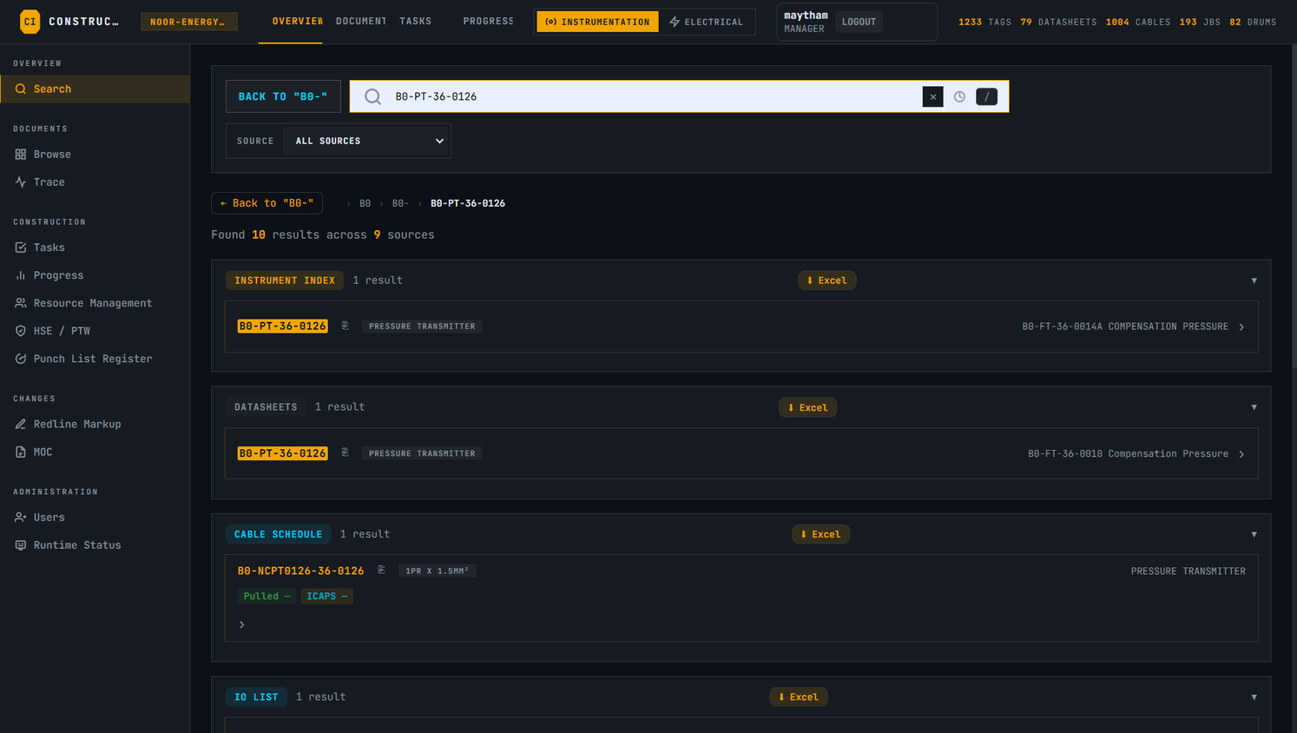
Noor Renewable Energy
REAL SITE USE CASE
An engineer needs to install an instrument such as PT-101. Instead of searching through multiple documents, the engineer enters the tag number and immediately sees the relevant information such as the I/O type, document number and revision, cable path from the instrument to the system cabinet, etc...

Slide 7
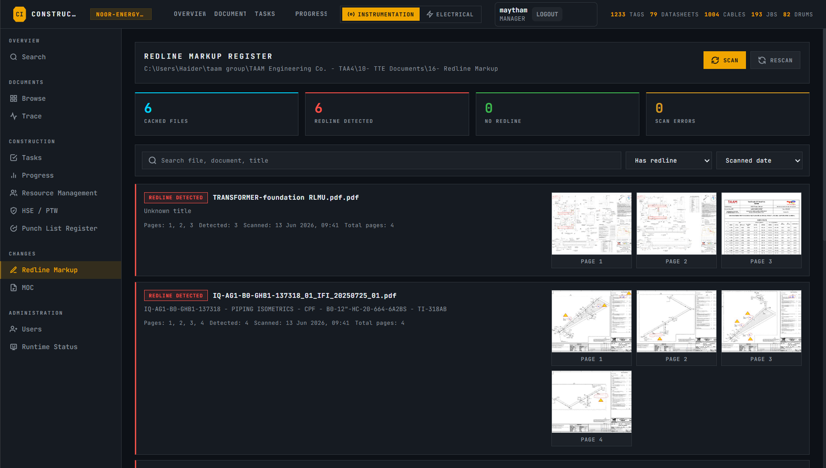
Noor Renewable Energy
REAL SITE USE CASE
During construction, an engineer needs to check whether the latest drawing contains any field modifications. Instead of manually opening and reviewing dozens of PDF pages, the engineer opens the Redline Markup screen. ConstructIQ automatically identifies the pages containing redline changes and links them to the corresponding document number and title. The engineer can immediately open the affected page, review the modification, and mark it as processed once the change has been incorporated into the project documentation.

Slide 8
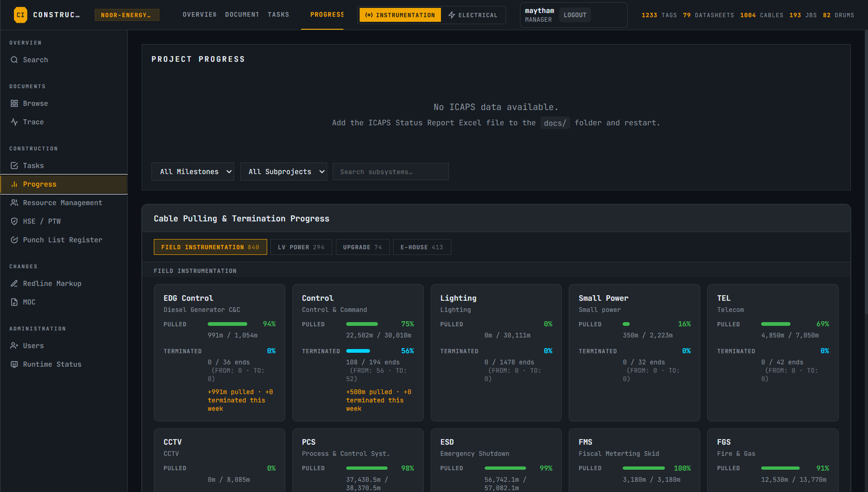
Noor Renewable Energy
REAL SITE USE CASE
A project manager wants to know the current status of site activities without collecting updates from multiple engineers or manually reviewing Excel sheets. Using the Progress screen, the manager immediately sees the actual completion figures for instruments, cables and other construction activities. Progress can be reviewed by system, subsystem or activity, making it easy to identify completed work, remaining quantities and areas falling behind plan. This gives the project team a clear, data-driven view of the site's current status.

Slide 9

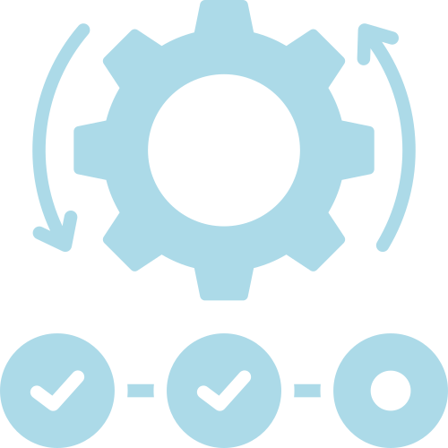

Noor Renewable Energy
Time Efficiency
Engineers spend less time searching and more time executing.
BUSINESS VALUE
Construction Accuracy
The platform reduces hidden losses caused by document searching, repeated questions, wrong installations, and slow progress reporting.
Clear data reduces installation errors and rework.
Project Visibility
Managers gain better insight into work progress and engineering status.

Slide 10

Noor Renewable Energy
IMPLEMENTATION ROADMAP (NEXT STEPS)
Phase 1: Secure Data Handover
Phase 2: Engine Ingestion & Parsing
The buyer provides the official project document package including instrument indexes, cable schedules, wiring diagrams, loop drawings, and I/O lists.
Our unique extraction tool processes your PDFs, maps out the tag logic, and populates the structured database.
Phase 3: Environment Deployment
Phase 4: Validation & On-Site Go-Live
We configure the high-performance local PC/server on your site OR provision your secure, fully managed online cloud environment.
We cross-check the system's tag search accuracy, conduct a quick training session for your field engineers, and hand over deployment keys for immediate site use.

Slide 11
Noor Renewable Energy
CONCLUSION
E&I Construction Management is not just a document viewer. It is the foundation for a centralized site engineering intelligence platform.
It connects project documents, tag data, cable paths, field tasks, progress tracking, inventory, manpower, and future maintenance support into one system.
For construction projects, it helps engineers execute faster.
For managers, it improves visibility.
For companies, it reduces delay, rework, and knowledge loss.

Slide 12

Noor Renewable Energy
THANK YOU
https://noorenergy-iq.com

Slide 13




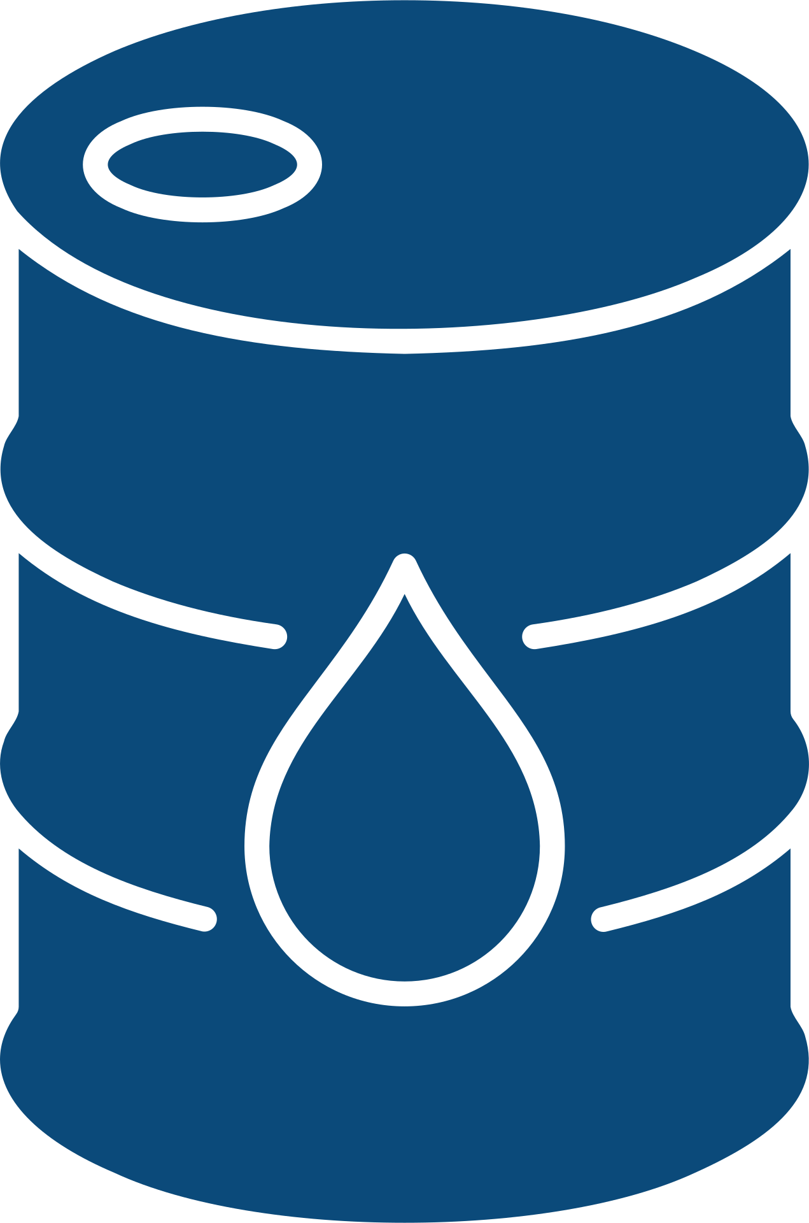
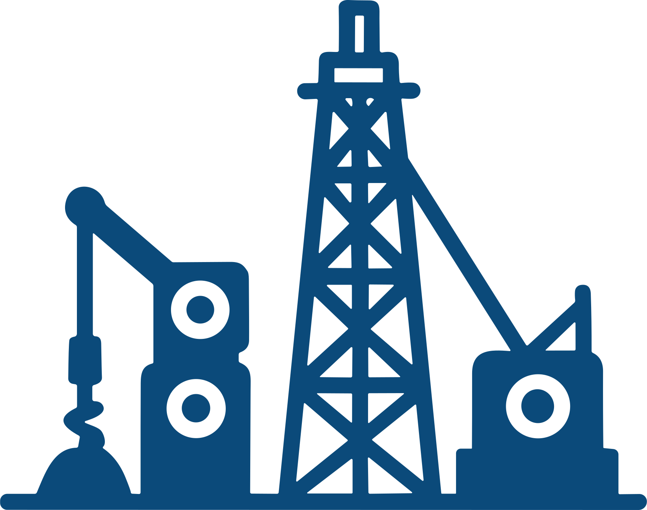


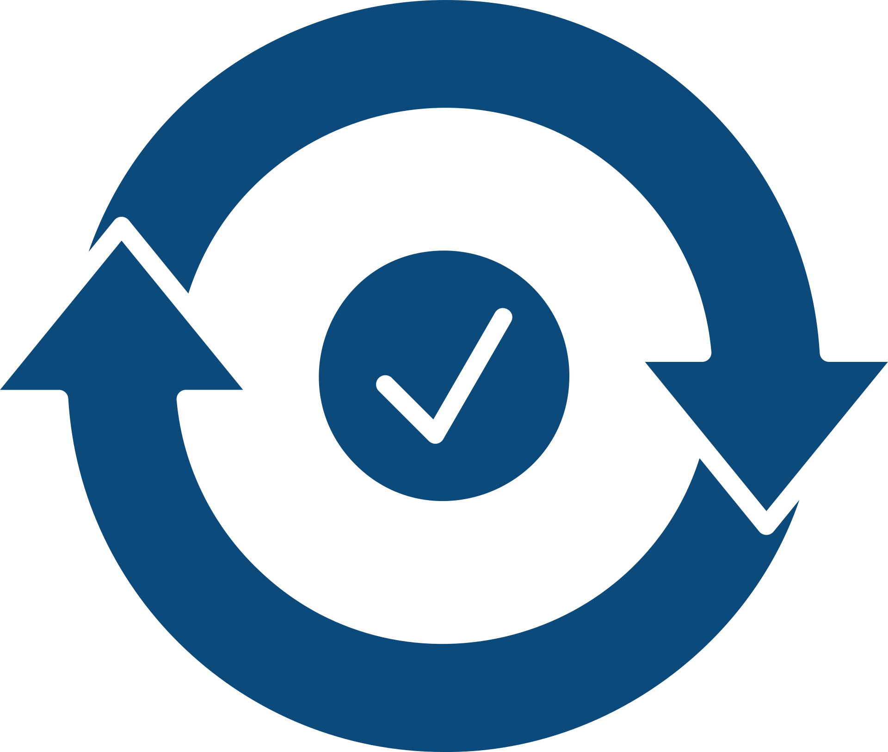


RESOURCE PAGE
Use these design resources in your Canva Presentation. Happy designing!
Delete or hide this page before.

